Slide 1
Learning Objectives for Today
After today’s class you should be able to:
Define and compare ionic/covalent bonds
Predict the rough properties of materials with different kinds of bonds
Guess what kind of bonding should occur for specific materials and justify with things you’ve learned about bonding

Slide 2
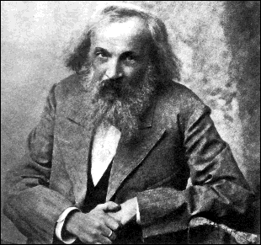
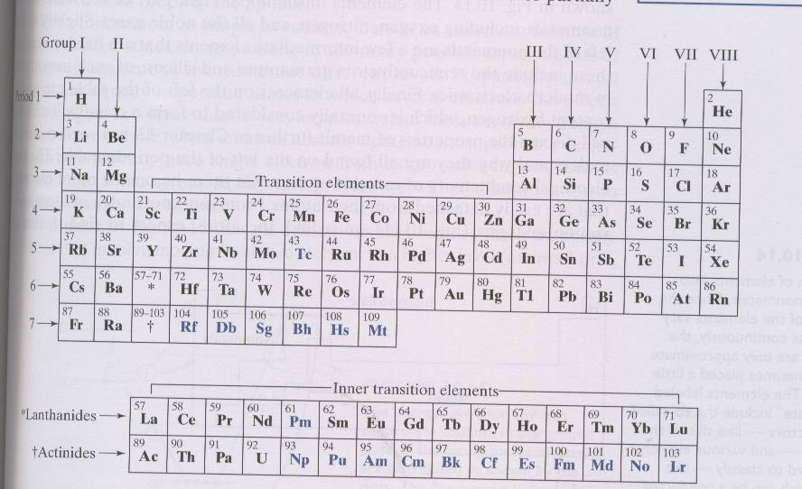
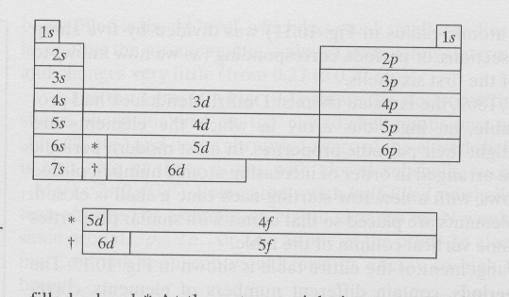
Organization of Periodic Table
Dmitri Mandeleev
Columns: groups with similar shells, similar properties
Rows: periods with elements with increasingly-full shells
Metallic/insulating properties can be understood by how loose (i.e. low ionization energy) outer electrons are.
So, on which side of the table are the metals?

Slide 3
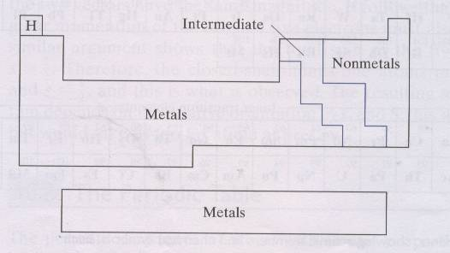
Organization of Periodic Table
Dmitri Mandeleev
Columns: groups with similar shells, similar properties
Rows: periods with elements with increasingly-full shells
Metallic/insulating properties can be understood by how loose (i.e. low ionization energy) outer electrons are.
So, on which side of the table are the metals?

Slide 4
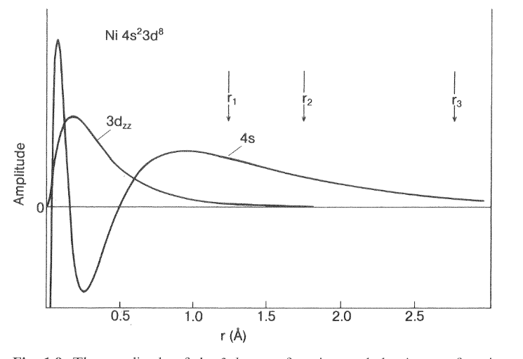
How the mobile electrons become mobile
When we bring Na atoms together to form a Na metal, the orbitals overlap slightly and the
valance electrons become no longer attached to a particular ion, but belong to both.
+
+
+
+
+
+
Na metal

Slide 5
How the mobile electrons become mobile
When we bring Na atoms together to form a Na metal, the orbitals overlap slightly and the
valance electrons become no longer attached to a particular ion, but belong to both.
This is another type of bonding called metallic bonding, stronger than van der Waals but weaker than ionic/covalent.
+
+
+
+
+
+
Na metal

Slide 6
METALLIC PROPERTIES
All conduction e⁻s in a metal combine to form a sea of electrons that move freely between cores → high electrical and thermal conductivity.
Notes:
AKA Fermi sea of electrons

Slide 7
METALLIC PROPERTIES
All conduction e⁻s in a metal combine to form a sea of electrons that move freely between cores → high electrical and thermal conductivity.
More electrons=stronger attraction. Means melting and boiling points are higher, and metal is stronger and harder.
The free electrons act as the bond (or a “glue”) between the positive ions.
Notes:
AKA Fermi sea of electrons

Slide 8
METALLIC PROPERTIES
All conduction e⁻s in a metal combine to form a sea of electrons that move freely between cores → high electrical and thermal conductivity.
More electrons=stronger attraction. Means melting and boiling points are higher, and metal is stronger and harder.
The free electrons act as the bond (or a “glue”) between the positive ions.
This type of bonding is nondirectional and
rather insensitive to structure.
Notes:
AKA Fermi sea of electrons

Slide 9

METALLIC PROPERTIES
All conduction e⁻s in a metal combine to form a sea of electrons that move freely between cores → high electrical and thermal conductivity.
More electrons=stronger attraction. Means melting and boiling points are higher, and metal is stronger and harder.
The free electrons act as the bond (or a “glue”) between the positive ions.
This type of bonding is nondirectional and
rather insensitive to structure.
As a result we have a high ductility of metals:
the “bonds” do not “break” when atoms are
rearranged – metals can experience a
significant degree of plastic deformation.
Notes:
AKA Fermi sea of electrons

Slide 10
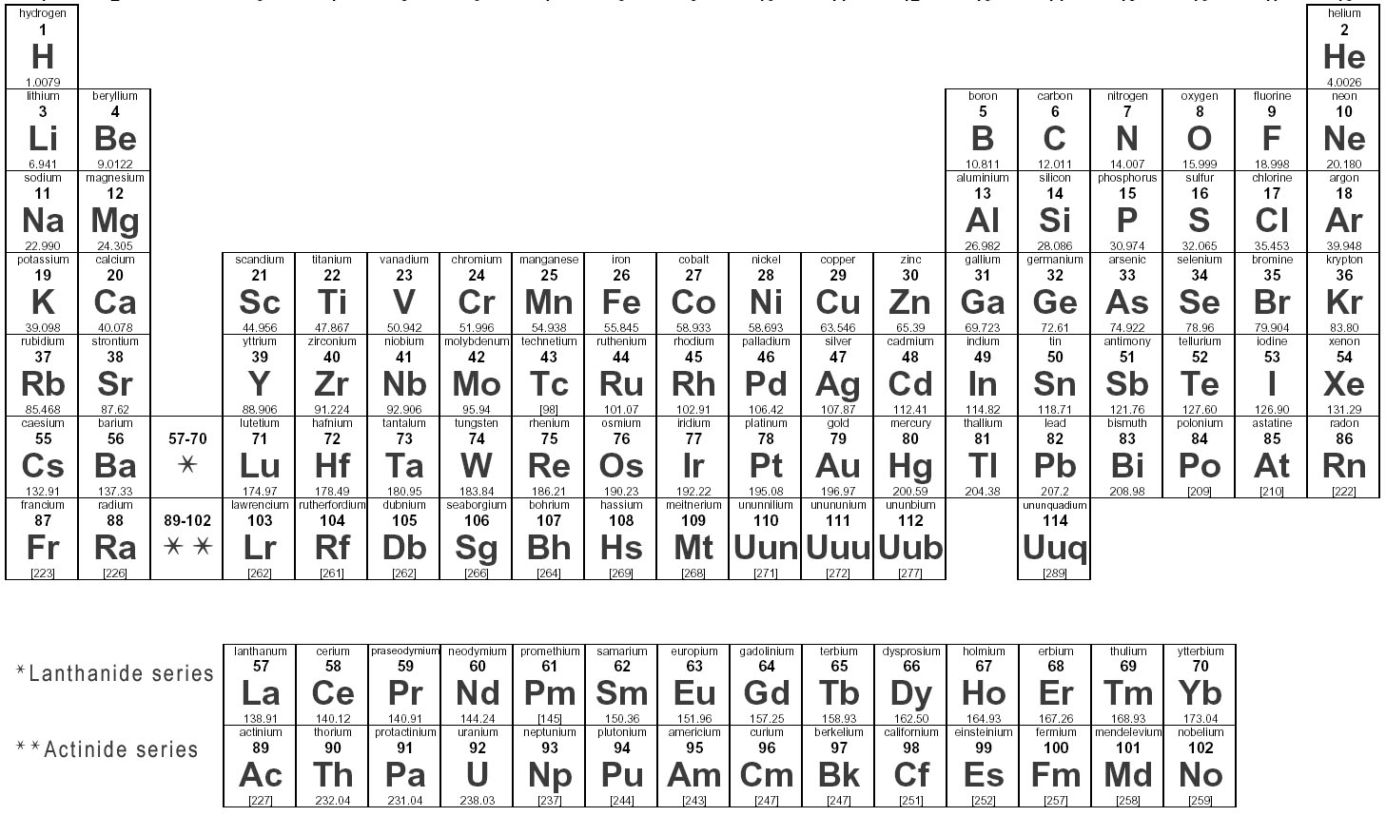
What happens if we combine different elements?
What might be logical groups of elements to consider first?

Slide 11
Combining alkalis and halogens
Closed-shell elements: noble gases
Closed-shell–minus-one elements (halogens): elements with high electron affinity A (energy gained when an additional electron is added to a neutral atom); will easily form negative ions (take additional electron) in remaining p-shell state; very reactive
Closed-shell –plus one (alkali) elements: reactive due to loosely-bound outer electron in s-shell
Notes:
Valence of 7? No. Our term valence here refers to loosely bound electrons. The halogens would rather gain an electron than give any away. (We will discuss later the confusion of the term valence as it’s used in chemistry too.)
Would group 1 elements react to noble gases? No. Their orbits are full. However, in the adjacent column are atoms that would really like one more electron to fill their orbits.

Slide 12
Electronegative and Electropositive
An atom is electronegative if it gains energy by gaining an extra electron.
What group of elements are very electronegative?

Slide 13
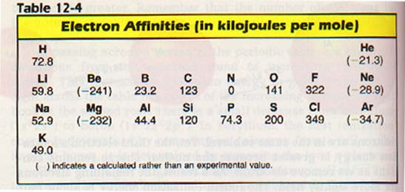
Electronegative and Electropositive
An atom is electronegative if it gains energy by gaining an extra electron.
What group of elements are very electronegative?
Why are the Group I elements electronegative?

Slide 14
Electronegative and Electropositive
An atom is electronegative if it gains energy by gaining an extra electron.
What group of elements are very electronegative?
Why are the Group I elements electronegative?
What if you join Na and Cl together?

Slide 15
Bonding
Elemental Na (group 1) would be metallic, but you can change that if brought in contact with a more electronegative element (e.g. Cl)
Notes:
Figure on page 9 of Holgate

Slide 16
NaCl (salt)
Draw the K, L & M shells (as circles) of Na (11) and Cl (17) before and after bringing in contact.

Slide 17
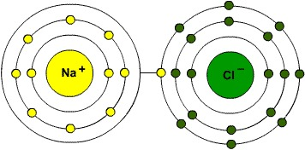
Ions and Cations and Anions, Oh My!
NaCl (salt)
Draw the K, L & M shells (as circles) of Na (11) and Cl (17) before and after bringing in contact.
Anion = Negative ion (atom with extra electrons)
Cation = Positive ion (atom missing electrons)

Slide 18
Ions and Cations and Anions, Oh My!
NaCl (salt)
Draw the K, L & M shells (as circles) of Na and Cl before and after bringing in contact.
Anion = Negative ion (atom with extra electrons)
Cation = Positive ion (atom missing electrons)
Which is the anion?
Which is the cation?

Slide 19
Ions and Cations and Anions, Oh My!
NaCl (salt)
Draw the K, L & M shells (as circles) of Na and Cl before and after bringing in contact.
Anion = Negative ion (atom with extra electrons)
Cation = Positive ion (atom missing electrons)
Which is the anion?
Which is the cation?
Which is/are electronegative?

Slide 20
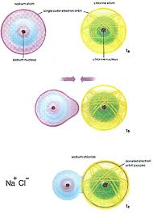
The Ionic Bond: a transferred electron
What energies should we know in case of NaCl?
Notes:
Ke2=1.44eVnm so Rc is a little less than 1 nm. The lattice parameter for NaCl is actually 0.564 nm (and that’s ~twice R).

Slide 21
The Ionic Bond: a transferred electron
What energies should we know?
Notes:
Ke2=1.44eVnm so Rc is a little less than 1 nm. The lattice parameter for NaCl is actually 0.564 nm (and that’s ~twice R).

Slide 22
The Ionic Bond: a transferred electron
What energies should we know?
+
R
-
Na⁺
Cl⁻
Since ΔE >0, this will not happen if the atoms are far away
Notes:
Ke2=1.44eVnm so Rc is a little less than 1 nm. The lattice parameter for NaCl is actually 0.564 nm (and that’s ~twice R).

Slide 23
The Ionic Bond: a transferred electron
What energies should we know?
+
R
-
Na⁺
Cl⁻
Since ΔE >0, this will not happen if the atoms are far away
As the atoms move closer, forming an ionic bond becomes energetically favorable due to coulomb potential energy
Notes:
Ke2=1.44eVnm so Rc is a little less than 1 nm. The lattice parameter for NaCl is actually 0.564 nm (and that’s ~twice R).

Slide 24
The Ionic Bond: a transferred electron
What energies should we know?
Reminder: k=1/4πε_{o} = 9 x 10⁹ Vm/C,
ke²=1.44 eV nm
+
R
-
Na⁺
Cl⁻
Since ΔE >0, this will not happen if the atoms are far away
As the atoms move closer, forming an ionic bond becomes energetically favorable due to coulomb potential energy
Total energy of ion as a function of separation R is
The ionic bond will form when E(R) becomes negative.
Notes:
Ke2=1.44eVnm so Rc is a little less than 1 nm. The lattice parameter for NaCl is actually 0.564 nm (and that’s ~twice R).

Slide 25
The Ionic Bond: a transferred electron
What energies should we know?
Reminder: k=1/4πε_{o} = 9 x 10⁹ Vm/C,
ke²=1.44 eV nm
+
R
-
Na⁺
Cl⁻
Since ΔE >0, this will not happen if the atoms are far away
As the atoms move closer, forming an ionic bond becomes energetically favorable due to coulomb potential energy
Total energy of ion as a function of separation R is
The ionic bond will form when E(R) becomes negative.
Find R_{c} in nm for NaCl.
Notes:
Ke2=1.44eVnm so Rc is a little less than 1 nm. The lattice parameter for NaCl is actually 0.564 nm (and that’s ~twice R).

Slide 26
The Ionic Bond: a transferred electron
What energies should we know?
Reminder: k=1/4πε_{o} = 9 x 10⁹ Vm/C,
ke²=1.44 eV nm
+
R
-
Na⁺
Cl⁻
Since ΔE >0, this will not happen if the atoms are far away
As the atoms move closer, forming an ionic bond becomes energetically favorable due to coulomb potential energy
Total energy of ion as a function of separation R is
The ionic bond will form when E(R) becomes negative.
Find R_{c} in nm for NaCl.
This happens when R is below the critical distance
at which E(R) = 0.
Notes:
Ke2=1.44eVnm so Rc is a little less than 1 nm. The lattice parameter for NaCl is actually 0.564 nm (and that’s ~twice R).

Slide 27
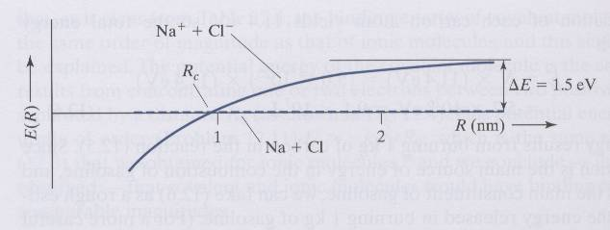
Will the ions stay at R_{c} apart?
R_{c} is the minimum distance needed to encourage bonding but they can continue to move closer
NaCl critical distance is

Slide 28
The Ionic Bond
In reality, ions will not get infinitely close to each other because ?
  repulsion between nuclei
  electrons in the same region can not occupy the same quantum states (Pauli exclusion principle), thus increasing the energy of the ion
Notes:
Is that the whole picture? If it were, what would happen to these ions? They would get a lot closer to minimize energy.
Note that n was a lot larger for noble gases where n=12. Also note that here we have 1/r where we had 1/r^6 as the prior attractive potential

Slide 29
The Ionic Bond
In reality, ions will not get infinitely close to each other because ?
  repulsion between nuclei
  electrons in the same region can not occupy the same quantum states (Pauli exclusion principle), thus increasing the energy of the ion
Effective potential
2nd term describes repulsion (two free parameters: B and 6<n<10)
Notes:
Is that the whole picture? If it were, what would happen to these ions? They would get a lot closer to minimize energy.
Note that n was a lot larger for noble gases where n=12. Also note that here we have 1/r where we had 1/r^6 as the prior attractive potential

Slide 30
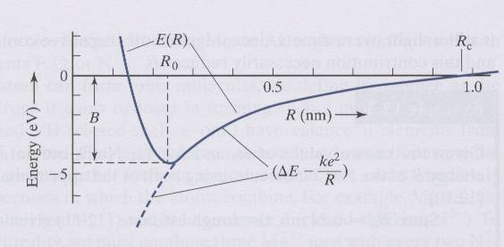
The Ionic Bond
In reality, ions will not get infinitely close to each other because ?
  repulsion between nuclei
  electrons in the same region can not occupy the same quantum states (Pauli exclusion principle), thus increasing the energy of the ion
Effective potential
2nd term describes repulsion (two free parameters: B and 6<n<10)
This leads to a minimum energy as a function of R which defines distance between ions in molecule:
Notes:
Is that the whole picture? If it were, what would happen to these ions? They would get a lot closer to minimize energy.
Note that n was a lot larger for noble gases where n=12. Also note that here we have 1/r where we had 1/r^6 as the prior attractive potential

Slide 31
The Ionic Bond
In reality, ions will not get infinitely close to each other because ?
  repulsion between nuclei
  electrons in the same region can not occupy the same quantum states (Pauli exclusion principle), thus increasing the energy of the ion
Effective potential
2nd term describes repulsion (two free parameters: B and 6<n<10)
This leads to a minimum energy as a function of R which defines distance between ions in molecule:
A reasonable approximation for the binding energy can be obtained from R₀:
Notes:
Is that the whole picture? If it were, what would happen to these ions? They would get a lot closer to minimize energy.
Note that n was a lot larger for noble gases where n=12. Also note that here we have 1/r where we had 1/r^6 as the prior attractive potential

Slide 32
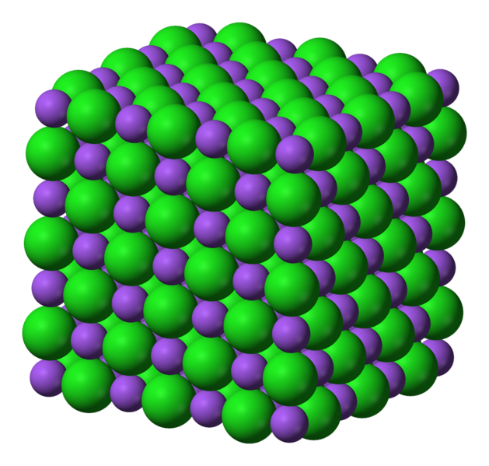
Approximate for NaCl
Reminder: k=1/4πε_{o} = 9 x 10⁹ Vm/C,
ke²=1.44 eV nm
What do we need to know?
Notes:
No Ro is not Rc
We could look it up. Probably best way honestly, but we already have some information about NaCl, so let’s consider if we added the ionic radii, at least.

Slide 33
Approximate for NaCl
Reminder: k=1/4πε_{o} = 9 x 10⁹ Vm/C,
ke²=1.44 eV nm
What do we need to know?
ΔE_{NaCl} = 1.5 eV (Na ionization – Cl affinity)
Notes:
No Ro is not Rc
We could look it up. Probably best way honestly, but we already have some information about NaCl, so let’s consider if we added the ionic radii, at least.

Slide 34
Approximate for NaCl
Reminder: k=1/4πε_{o} = 9 x 10⁹ Vm/C,
ke²=1.44 eV nm
What do we need to know?
ΔE_{NaCl} = 1.5 eV (Na ionization – Cl affinity)
Is R_{o} = R_{c}?
Notes:
No Ro is not Rc
We could look it up. Probably best way honestly, but we already have some information about NaCl, so let’s consider if we added the ionic radii, at least.

Slide 35
Approximate for NaCl
Reminder: k=1/4πε_{o} = 9 x 10⁹ Vm/C,
ke²=1.44 eV nm
What do we need to know?
ΔE_{NaCl} = 1.5 eV (Na ionization – Cl affinity)
Is R_{o} = R_{c}?
How else might we determine it?
Notes:
No Ro is not Rc
We could look it up. Probably best way honestly, but we already have some information about NaCl, so let’s consider if we added the ionic radii, at least.
Actually, The crystal lattice parameter is 0.563 nm. You’d take half of this. Again, the hard sphere model is only an approximation.

Slide 36
Approximate for NaCl
Reminder: k=1/4πε_{o} = 9 x 10⁹ Vm/C,
ke²=1.44 eV nm
What do we need to know?
ΔE_{NaCl} = 1.5 eV (Na ionization – Cl affinity)
Is R_{o} = R_{c}?
How else might we determine it?
How could we find the radius of Na⁺? Cl⁻?
Notes:
No Ro is not Rc
We could look it up. Probably best way honestly, but we already have some information about NaCl, so let’s consider if we added the ionic radii, at least.
Actually, The crystal lattice parameter is 0.563 nm. You’d take half of this. Again, the hard sphere model is only an approximation.
.

Slide 37
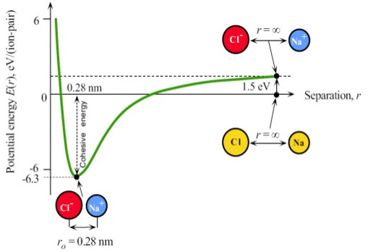
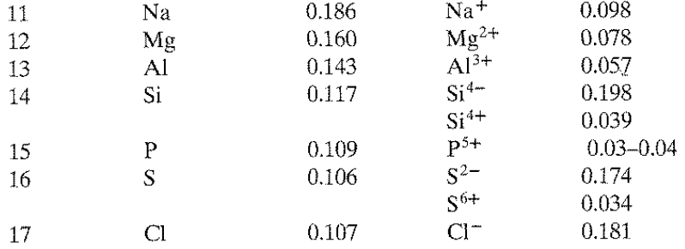
Approximate for NaCl
Reminder: k=1/4πε_{o} = 9 x 10⁹ Vm/C,
ke²=1.44 eV nm
What do we need to know?
ΔE_{NaCl} = 1.5 eV (Na ionization – Cl affinity)
Is R_{o} = R_{c}?
How else might we determine it?
How could we find the radius of Na⁺? Cl⁻?
Notes:
No Ro is not Rc
We could look it up. Probably best way honestly, but we already have some information about NaCl, so let’s consider if we added the ionic radii, at least.
Actually, The crystal lattice parameter is 0.563 nm. You’d take half of this. Again, the hard sphere model is only an approximation.

Slide 38
Attractive Force Rather than Binding Energy
Reminder: k=1/4πε_{o} = 9 x 10⁹ Vm/C
You might also see this done in terms of force. Calculate the coulombic force of attraction between Na⁺ and Cl⁻.
Notes:
I don’t really care if you look up the lattice parameter for r or use the Appendix to approximate that lattice parameters. It’s not a bad idea to be comfortable with both. On the test, I won’t let you google lattice parameters. ☺

Slide 39
Attractive Force Rather than Binding Energy
Reminder: k=1/4πε_{o} = 9 x 10⁹ Vm/C
You might also see this done in terms of force. Calculate the coulombic force of attraction between Na⁺ and Cl⁻.
Z is the effective charge of the ion. What are the affective charges of Na and Cl?
Notes:
I don’t really care if you look up the lattice parameter for r or use the Appendix to approximate that lattice parameters. It’s not a bad idea to be comfortable with both. On the test, I won’t let you google lattice parameters. ☺

Slide 40
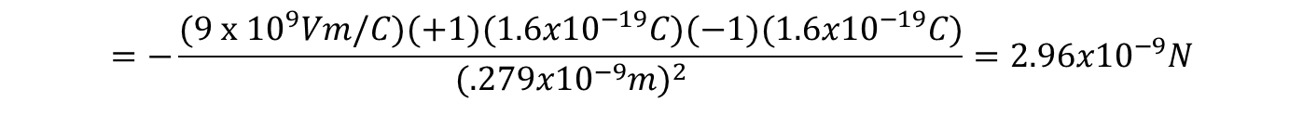
Attractive Force Rather than Binding Energy
Reminder: k=1/4πε_{o} = 9 x 10⁹ Vm/C
You might also see this done in terms of force. Calculate the coulombic force of attraction between Na⁺ and Cl⁻.
Z is the effective charge of the ion. What are the affective charges of Na and Cl?
$$=−\frac{(\text{9 }\text{x}\text{ 1}{\text{0}}^{9}Vm/C)(+1)(1.6x10^{−19}C)(−1)(1.6x10^{−19}C)}{(.279x10^{−9}m)^{2}}=2.96x10^{−9}N$$
Shown using ionic radius, could otherwise look up lattice parameter and divide by two (close)
Notes:
I don’t really care if you look up the lattice parameter for r or use the Appendix to approximate that lattice parameters. It’s not a bad idea to be comfortable with both. On the test, I won’t let you google lattice parameters. ☺

Slide 41
Ionic crystals have strong bonds
Property
Explanation
Melting point
and boiling point
The melting and boiling points of ionic compounds are high because a large amount of thermal energy is required to separate the ions which are bound by strong electrical forces.
Electrical
conductivity
Solid ionic compounds do not conduct electricity when a potential is applied because there are no mobile charged particles.
No free electrons causes the ions to be firmly bound and cannot carry charge by moving.
Hardness (Scratchable?)
Most ionic compounds are hard; the surfaces of their crystals are not easily scratched. This is because the ions are bound strongly to the lattice and aren't easily displaced.
Brittleness (Bendable?)
Most ionic compounds are brittle; a crystal will shatter if we try to distort it. This happens because distortion causes ions of like charges to come close together then sharply repel.

Slide 42
Ionic crystals have strong bonds
Property
Explanation
Melting point
and boiling point
The melting and boiling points of ionic compounds are high because a large amount of thermal energy is required to separate the ions which are bound by strong electrical forces.
Electrical
conductivity
Solid ionic compounds do not conduct electricity when a potential is applied because there are no mobile charged particles.
No free electrons causes the ions to be firmly bound and cannot carry charge by moving.
Hardness (Scratchable?)
Most ionic compounds are hard; the surfaces of their crystals are not easily scratched. This is because the ions are bound strongly to the lattice and aren't easily displaced.
Brittleness (Bendable?)
Most ionic compounds are brittle; a crystal will shatter if we try to distort it. This happens because distortion causes ions of like charges to come close together then sharply repel.

Slide 43
Ionic crystals have strong bonds
Property
Explanation
Melting point
and boiling point
The melting and boiling points of ionic compounds are high because a large amount of thermal energy is required to separate the ions which are bound by strong electrical forces.
Electrical
conductivity
Solid ionic compounds do not conduct electricity when a potential is applied because there are no mobile charged particles.
No free electrons causes the ions to be firmly bound and cannot carry charge by moving.
Hardness (Scratchable?)
Most ionic compounds are hard; the surfaces of their crystals are not easily scratched. This is because the ions are bound strongly to the lattice and aren't easily displaced.
Brittleness (Bendable?)
Most ionic compounds are brittle; a crystal will shatter if we try to distort it. This happens because distortion causes ions of like charges to come close together then sharply repel.

Slide 44
Ionic crystals have strong bonds
Property
Explanation
Melting point
and boiling point
The melting and boiling points of ionic compounds are high because a large amount of thermal energy is required to separate the ions which are bound by strong electrical forces.
Electrical
conductivity
Solid ionic compounds do not conduct electricity when a potential is applied because there are no mobile charged particles.
No free electrons causes the ions to be firmly bound and cannot carry charge by moving.
Hardness (Scratchable?)
Most ionic compounds are hard; the surfaces of their crystals are not easily scratched. This is because the ions are bound strongly to the lattice and aren't easily displaced.
Brittleness (Bendable?)
Most ionic compounds are brittle; a crystal will shatter if we try to distort it. This happens because distortion causes ions of like charges to come close together then sharply repel.

Slide 45
Ionic crystals have strong bonds
Property
Explanation
Melting point
and boiling point
The melting and boiling points of ionic compounds are high because a large amount of thermal energy is required to separate the ions which are bound by strong electrical forces.
Electrical
conductivity
Solid ionic compounds do not conduct electricity when a potential is applied because there are no mobile charged particles.
No free electrons causes the ions to be firmly bound and cannot carry charge by moving.
Hardness (Scratchable?)
Most ionic compounds are hard; the surfaces of their crystals are not easily scratched. This is because the ions are bound strongly to the lattice and aren't easily displaced.
Brittleness (Bendable?)
Most ionic compounds are brittle; a crystal will shatter if we try to distort it. This happens because distortion causes ions of like charges to come close together then sharply repel.

Slide 46
Bonding Type Affects Properties
  Ionic: involves transfer of an electron between two atoms, resulting in a net electrostatic attractive force

Slide 47
Bonding Type Affects Properties
  Ionic: involves transfer of an electron between two atoms, resulting in a net electrostatic attractive force
  Covalent: involves sharing of an electron between atoms

Slide 48
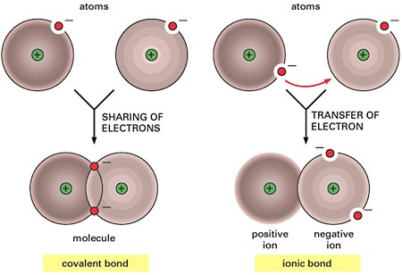
Bonding Type Affects Properties
  Ionic: involves transfer of an electron between two atoms, resulting in a net electrostatic attractive force
  Covalent: involves sharing of an electron between atoms
The type of bonding is determined mainly by the degree of overlap between the electronic wavefunctions of the atoms involved.

Slide 49
Covalent to Ionic Transition
Purely Covalent
Cation: positive ion
Anion: negative ion
Purely Ionic
Notes:
Mention perovskite form
Spinel group: A²⁺B³⁺₂O²⁻₄
_{Delefossite:} A1+B3+O2 covalent nature of AO bonds and both ionic and covalent in BO

Slide 50
Covalent to Ionic Transition
Purely Covalent
Cation: positive ion
Anion: negative ion
Purely Ionic
Notes:
Mention perovskite form
Spinel group: A²⁺B³⁺₂O²⁻₄
_{Delefossite:} A1+B3+O2 covalent nature of AO bonds and both ionic and covalent in BO

Slide 51
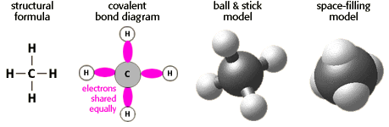
COVALENT BONDING
The covalent bonding is formed by sharing of outer shell electrons (i.e., s and p electrons) between atoms rather than by electron transfer.
Thus, the interaction between nearest neighbors is of prime importance!
Notes:
This nearest neighbor importance will actually simplify the modeling of covalent crystals in our future work. We’ll be able to ignore further interactions, which isn’t always a good assumption in other types of systems.

Slide 52
Covalent Bonding of Multielectron Atoms
For multielectron atoms covalent bonding is more likely to occur if there are unpaired electrons in an orbital
  Unpaired electrons can share the same orbital with another unpaired electron of opposite spin

Slide 53
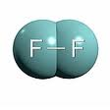
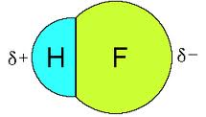
Covalent Bonding of Multielectron Atoms
For multielectron atoms covalent bonding is more likely to occur if there are unpaired electrons in an orbital
  Unpaired electrons can share the same orbital with another unpaired electron of opposite spin
Example
F: 1s²2s²2p_{x}²2p_{y}²2p_{z}¹
Fluorine has one unpaired electron, thus acts like H in forming covalent bonds
e.g.: F₂, HF

Slide 54
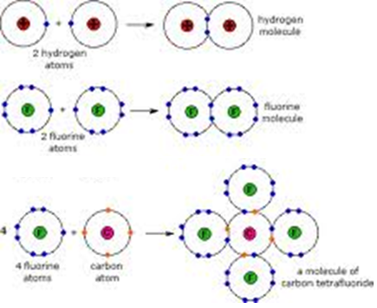
Covalent Bonding of Multielectron Atoms
For multielectron atoms covalent bonding is more likely to occur if there are unpaired electrons in an orbital
  Unpaired electrons can share the same orbital with another unpaired electron of opposite spin
Example
F: 1s²2s²2p_{x}²2p_{y}²2p_{z}¹
Fluorine has one unpaired electron, thus acts like H in forming covalent bonds
e.g.: F₂, HF

Slide 55
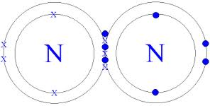
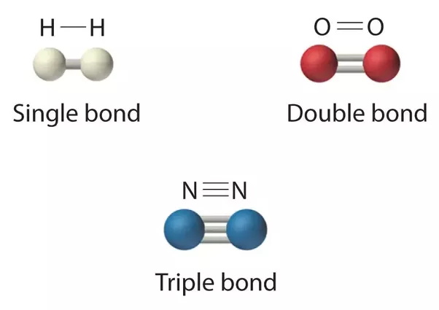
Covalent Bonding of Multielectron Atoms
N: 1s²2s²2p_{x}¹2p_{y}¹2p_{z}¹
N in ground state has three unoccupied p-orbital states in order to minimize repulsion energy between electrons
Nitrogen therefore has three electrons available for covalent bonding and can form molecules such as N₂ and NH₃ (ammonia)

Slide 56
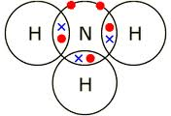

Covalent Bonding of Multielectron Atoms
N: 1s²2s²2p_{x}¹2p_{y}¹2p_{z}¹
N in ground state has three unoccupied p-orbital states in order to minimize repulsion energy between electrons
Nitrogen therefore has three electrons available for covalent bonding and can form molecules such as N₂ and NH₃ (ammonia)
In general, binding energy increases with number of bonds:
Molecule B (eV)
F₂ (1 bond) 1.6
O₂ (2 bonds) 5.1
N₂ (3 bonds) 9.8

Slide 57
Covalent Materials Also Strong Bonds
Property
Explanation
Melting point
and boiling point
Very high melting points because each atom is bound by strong covalent bonds. Many covalent bonds must be broken if the solid is to be melted and a large amount of thermal energy is required for this.
Electrical
conductivity
Poor conductors because electrons are held either on the atoms or within covalent bonds. They cannot move through the lattice.
Which do you think is more conducting?
Hardness
They are hard because the atoms are strongly bound in the lattice, and are not easily displaced.
Brittleness
Covalent network substances are brittle. If sufficient force is applied to a crystal, covalent bond are broken as the lattice is distorted. Shattering occurs rather than deformation of a shape.
Notes:
Which do you think is more conducting? Covalent, because more overlap.

Slide 58
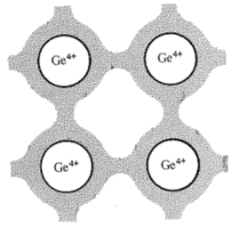
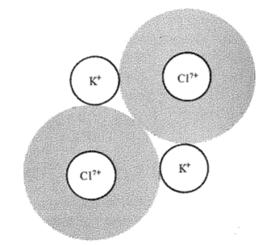
Covalent Materials Also Strong Bonds
Property
Explanation
Melting point
and boiling point
Very high melting points because each atom is bound by strong covalent bonds. Many covalent bonds must be broken if the solid is to be melted and a large amount of thermal energy is required for this.
Electrical
conductivity
Poor conductors because electrons are held either on the atoms or within covalent bonds. They cannot move through the lattice.
Which do you think is more conducting?
Hardness
They are hard because the atoms are strongly bound in the lattice, and are not easily displaced.
Brittleness
Covalent network substances are brittle. If sufficient force is applied to a crystal, covalent bond are broken as the lattice is distorted. Shattering occurs rather than deformation of a shape.
Notes:
Which do you think is more conducting? Covalent, because more overlap.

